Slide 1
TP400 - Pre PDR PBCU hardware Design
X July 2017

Slide 2
Agenda
TOPICS | Timing (min)
Program context / Objective of the review | 15
List of obsolescence & Maturity Design Obsolescence Management PBCU Reliability (PR / NCR) Design Maturity Improvement Thermal Capabilities Limitations | 30
Answers to Previous Recommandations | 30
Design Evolutions | 30
Verification / Validation / Qualification Plan | 30
Specification Compliance Matrix | 15
Safety Analysis | 15
Development Schedule | 15
Risk Analysis and Mitigation Plan | 20
Conclusion | 20

Slide 3
PROGRAM CONTEXT
Due to obsolescence, in-services events, to improve the reliability and maturity design, PBCU maturity plan is proposed:
Obsolescence
Maturity Plan
Reliability
Maturity Plan
In service Events
Thermal Capabilities
Limitations
Design
Maturity
Thermal
Design Maturity

Slide 4
OBJECTIVE OF THE REVIEW
Objective of the review is to define
PBCU evolutions to be implemanted
Life modification cycle
Analysis and test to be performed
Stategy validation and qualification plan

Slide 5
List of obsolescence & Maturity Design
N° | Description | Reason of change | comments
1 | +28Vdc Input Filter | Obsolescence | Production impact : end of 2018
2 | Gate Driver for 3-phase bridge transistor | Obsolescence | Introduce a new source in equivalence
3 | Transistor NPN 32V | Obsolescence | Introduce a new source in equivalence
4 | Overvoltage | Reliability | In service events (back EMF failure)
5 | DC/DC converter for CAN bus power | Reliability | Residual humidity on component
6 | Safran Aircraft Engines recommandations | Reliability
7 | Fuse | Reliability | In-service events and not requested by EPI
8 | Design error on discrete interface (SVOA & SVOB) | Design maturity improvement | No compliance on Airbus requirement
9 | PBCU HW Security | Design maturity improvement | Not requested by EPI
10 | Thermal Stamp | Design maturity improvement
11 | DC/DC converter - Thermal capabilities - Single source | Thermal Capabilities Limitations | Currently, PBCU is standardized up to ISA +22 Airbus requirement is ISA +40

Slide 6
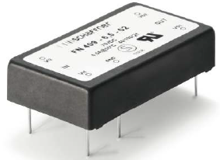
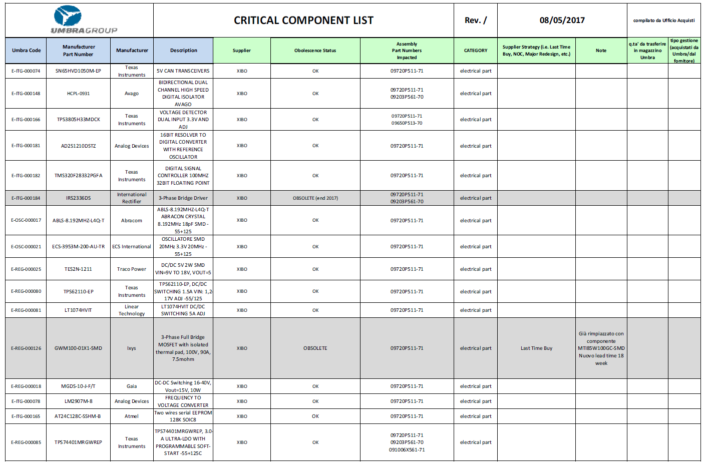
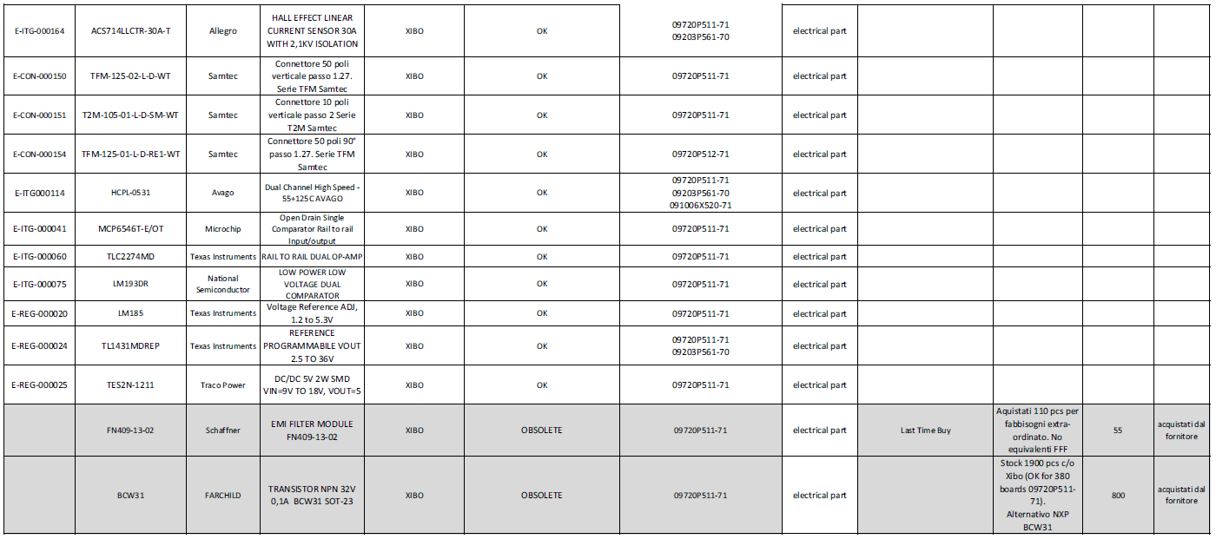
Obsolescence Management
Bill Of Material obsolescence status has been provided by Umbra (05/2017)
3 Obsolescences has been detected :
Input Filter
Not equivalent component identified
Umbra proposes a custom design
Gate Driver for 3-phase bridge transistor
An equivalent component has been identified
Transistor NPN 32V
An equivalent component has been identified

Slide 7
PBCU Realiability 1/3
Overvoltage
Observations
Treatment PR0163 attached to AR0386
H-bridge has been damaged by back EMF from PBU. H-bridge does not have dedicated protection hardware against over voltage.
Proposal solution
Add dedicated components in order to protect this part

Slide 8
PBCU Realiability 2/3
DC/DC converter for CAN bus power
Observations
Treatment PR0165 : DC/DC converter broken during ATP ESS cycle (-55°C)
Residual humidity on component or board after long warehouse time
Proposal solution
New component identified with package different, not Fit Form Function equivalent so PCB is impacted
Fuse
Observations
In service events and no requested by EPI
The protection is performed before by breaker
Proposal solution
Delete the fuse

Slide 9
PBCU Realiability 3/3
Safran Aircraft Engines recommandations
Observations
Observations of PBCU schematics shown design weaknesses
Instability of Operational Amplifiers in some usages
Some electronic components are overstressed
Tantalum capacitors
Aluminium capacitors
Minor error in schematics
Proposal solution
Safran Aircraft Engines recommandations are described in the presentation attached

Slide 10
Design Maturity Improvement 1/2
PBCU HW Security
Observations
HW security is design in the PBCU but HW Security is not requested by EPI (PR0161)
Proposal solution
Modification of triggering threshold for Propeller Speed comparator on HW Security
No modification with requirement management
Delete function

Slide 11
Design Maturity Improvement 2/2
Thermal Stamp
Observations
PBCU thermal limit cannot be detected because no thermal sensor is populated inside the PBCU box
Proposal solution
Adding of thermal stamps inside the PBCU case to detect over-temperatures

Slide 12
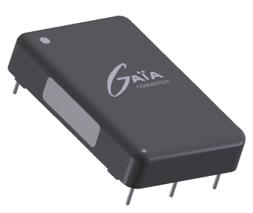
Thermal Capabilities Limitations
DC/DC converter
Observations
Currently, PBCU is standardized up to ISA +22
Airbus requirement is ISA +40
Proposal solution : Synqor component
Perfomance is better than actual component (temperature 125° vs 105°)
Risks
Potential export issue (US component)
2nd solution with many component is not available yet
New proposal is a single source

Slide 13
Answers to Previous Recommandations
To be updated by UMBRA

Slide 14
Design Evolutions 1/2
N° | Description | Reason of change | Solution | MOD Life Cycle | P/N Change | comments
1 | +28Vdc Input Filter | Obsolescence | Custom Design | MOD | No | Production impact : end of 2018
2 | Gate Driver for 3-phase bridge transistor | Obsolescence | Equivalent component | CDAR | No | Introduce a new source in equivalence
3 | Transistor NPN 32V | Obsolescence | Equivalent component | CDAR | No | Introduce a new source in equivalence
4 | Overvoltage | Reliability | Protection of the HW against overvoltage | MOD | No | In service events (back EMF failure)
5 | DC/DC converter for CAN bus power | Reliability | New component | MOD | No | Residual humidity on component
6 | Safran Aircraft Engines recommandations | Reliability | Design Improvement | MOD | No | Improve the reliability
7 | Fuse | Reliability | Fuse is deleted | MOD | No | In-service events and not requested by EPI

Slide 15
Design Evolutions 2/2
N° | Description | Reason of change | Solutions | MOD Life Cycle | P/N Change | comments
8 | Design error on discrete interface (SVOA & SVOB) | Design maturity improvement |  | MOD | No | No compliance on Airbus requirement
9 | PBCU HW Security | Design maturity improvement | Delete function Modification of triggering threshold No modification of triggering threshold | MOD | No | Not requested by EPI
10 | Thermal Stamp | Design maturity improvement | Thermal Stamp | CDAR | No
11 | DC/DC converter - Thermal capabilities - Single source | Thermal Capabilities Limitations | New converter with perfomance is better than the old one Other solution with many components | MOD | Yes | Currently, PBCU is standardized up to ISA +22 Airbus requirement is ISA +40

Slide 16
Verification / Validation / Qualification Plan 1/2
N° | Description | Reason of change | Reconciliation | Comments
1 | +28Vdc Input Filter | Obsolescence | Power input EMI Vibration Temperature TBC CS-E 80, etc….
2 | Gate Driver for 3-phase bridge transistor | Obsolescence | Analysis | ATP with new component
3 | Transistor NPN 32V | Obsolescence | Analysis | ATP with new component
4 | Overvoltage | Reliability | Vibration Temperature TBC
5 | DC/DC converter for CAN bus power | Reliability | Vibration Temperature TBC
6 | Safran Aircraft Engines recommandations | Reliability | Analysis | ATP with new component
7 | Fuse | Reliability | Analysis
To be updated by UMBRA

Slide 17
Verification / Validation / Qualification Plan 2/2
N° | Description | Reason of change | Reconciliation | comments
8 | Design error on discrete interface (SVOA & SVOB) | Design maturity improvement
9 | PBCU HW Security | Design maturity improvement | Depending solution
10 | Thermal Stamp | Design maturity improvement | Analysis
11 | DC/DC converter - Thermal capabilities - Single source | Thermal Capabilities Limitations | Power input EMI Vibration Temperature TBC
To be updated by UMBRA

Slide 18
Safety Analysis
To be updated by UMBRA

Slide 19
Development Schedule
To be updated by UMBRA

Slide 20
Risk Analysis and Mitigation Plan
To be updated by
Safran Aircraft Engines & UMBRA
# | Item | Description | Actions | Responsible | Probability X Gravity
1
2
3

Slide 21
Conclusion
To be updated by
Safran Aircraft Engines & UMBRA

